Slide 1

Sharpe Portfolio 2
Otegen – Namazdli – Eshnazarov – Khairullina
GROUP 9

Slide 2
In this project a market with 𝑛 risky assets and a risk-free one is considered, with a risk-free interest rate 𝑅𝐹.
In the specific application, the number of risky assets is 𝑛 = 5, and return series are observed for these stocks (𝑇 = 35).
Observed series are included in the file Sharpe-Prices-Dataset-G9.xls.
We want to apply a risk-return approach to portfolio selection by using the optimization model based on the maximization of the Sharpe Ratio (Sharpe Portfolio).

Slide 3
Theoretical part
Exceel solver
Graphs and results

Slide 4

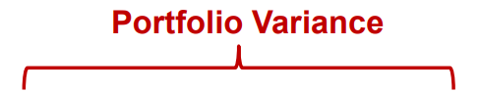
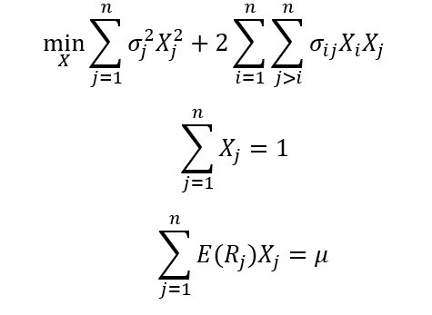
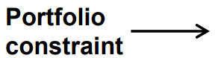
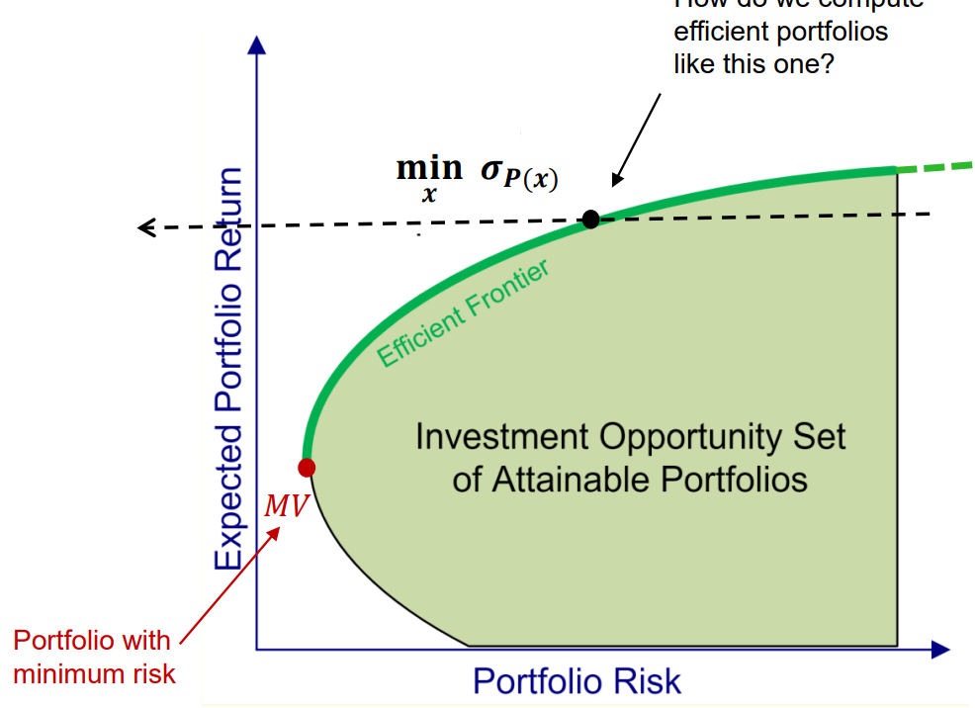
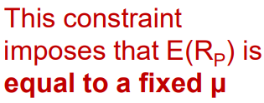
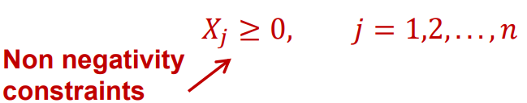
MwV
The optimization problem seeks to minimize the portfolio variance subject to the constraints on expected return and portfolio weights

Slide 5
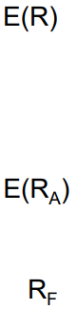
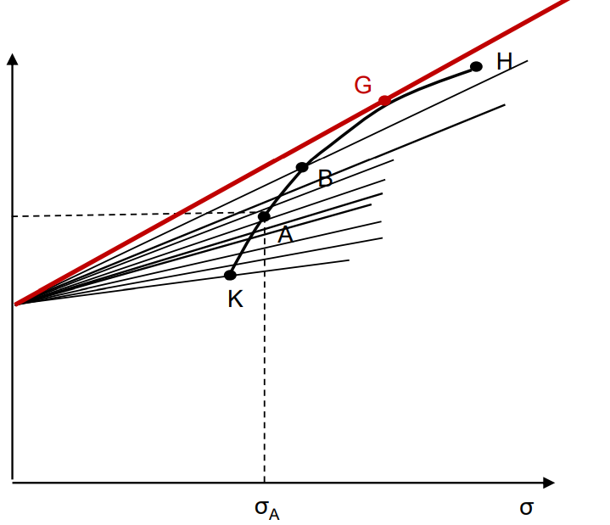
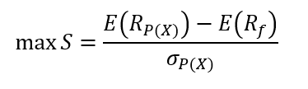
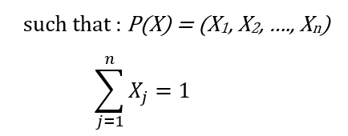
Sharpe ratio optimization model
The Sharpe optimization model is a portfolio optimization framework where the objective function is to find the portfolio that maximizes the Sharpe ratio
Sharpe ratio is a measure of the risk-adjusted return of an investment, that calculates the excess return per unit of risk taken
It compares the average return of a portfolio to the return of a risk-free asset, adjusting for the portfolio's standard deviation (risk).
A higher Sharpe ratio indicates a better risk-adjusted performance
Used for evaluating and comparing different portfolios.

Slide 6

What we did in excel step by step(2.1 and 2.2)
The expected return of each asset is calculated by using the Average function
After finding average return for assets , we should calculate the variance-covariance matrix of the asset returns to input data for the Markowitz model. This requires transposing a 5x35 matrix of returns for the given data. The input area should be 5 rows and 35 columns, with the column headers repeated every 26 columns. The function TRANSPOSE should be applied to the entire table.

Slide 7
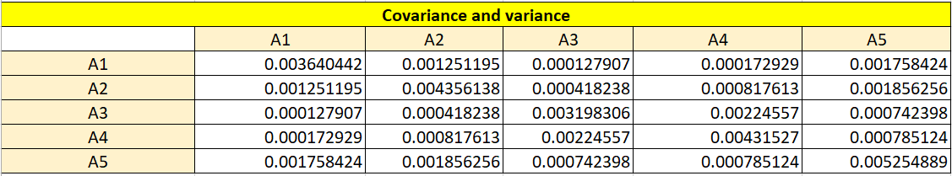
To prepare the input data for Markowitz model, it is necessary to compute the variance and covariance matrix of the returns of the assets.
This is done by:
first finding the expected returns of each asset using the average function
the covariance and variance matrix is found using the COVARIANCE.P function.
The input for this function is the pairs of columns from the first matrix and the transpose of the first matrix

Slide 8
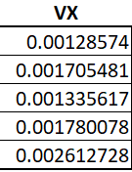
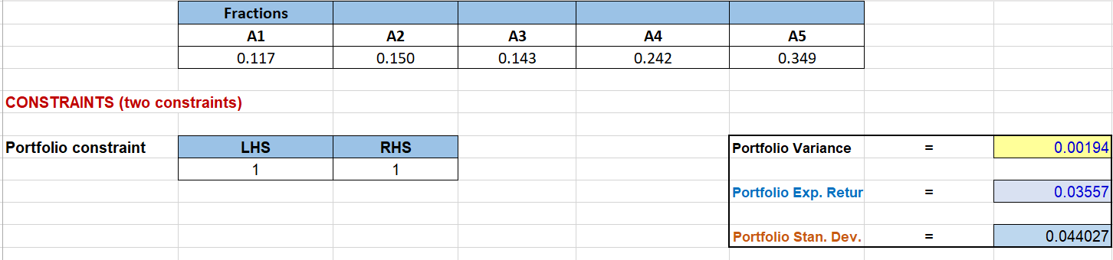
Now I want to talk about MMULT function and portfolio variance. This function used to perform matrix multiplication. To find the portfolio variance using the MMULT function in Excel, you need to calculate the following:
Here, the MMULT function is used twice, first to calculate the product of the portfolio weights vector and the covariance matrix, and then to calculate the product of the resulting matrix(VX) and portfolio weights vector.

Slide 9
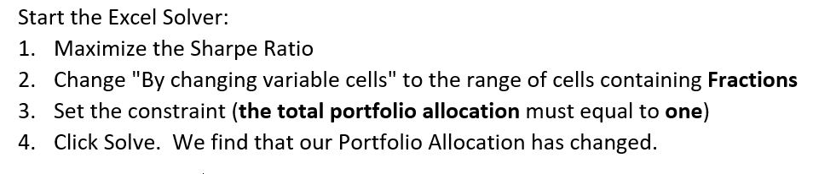
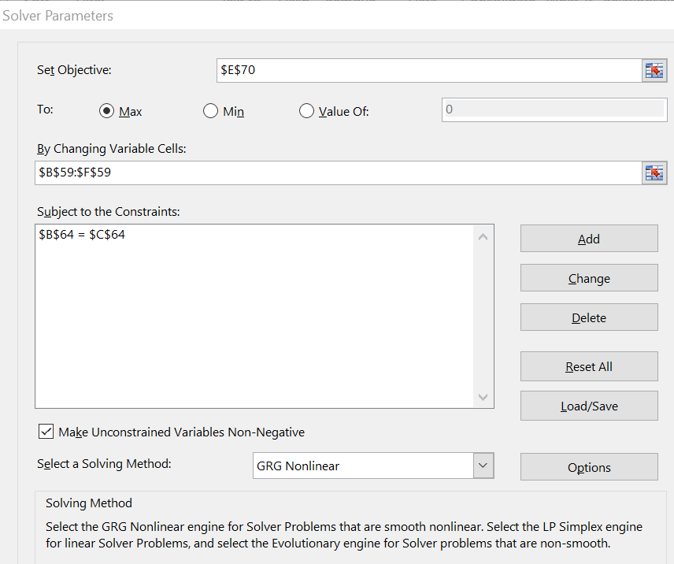
Then we formulate Sharpe Ratio model using data computed above(2.1) and assume Rf=0.01. We solved optimization model by using Excel Solver
We maximized our Sharpe Ratio and we find fractions
Sharpe ratio
P_001 | 0.580872674

Slide 10

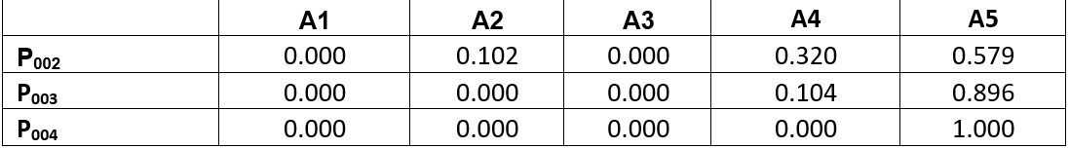
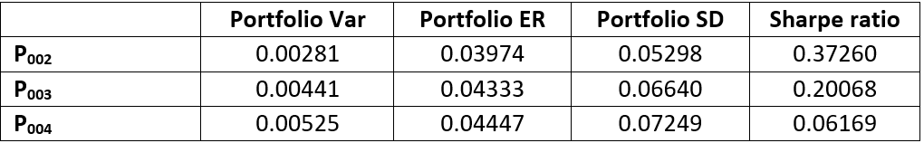
2.3 exercise
We do exactly the same process to find the optimum portfolio with the highest Sharpe ratio where the risk-free rate is equal to R_{f} =0.02, 0.03, 0.04
In the table we indicated each portfolio with given risk-free rate. Also we got the expected return and standard deviation, variance and also Sharpe ratio of the each portfolio.
After computing the Sharpe ratio of all portfolio at different risk-free rate. We can summarize and select which portfolio is the most attractive for investors

Slide 11
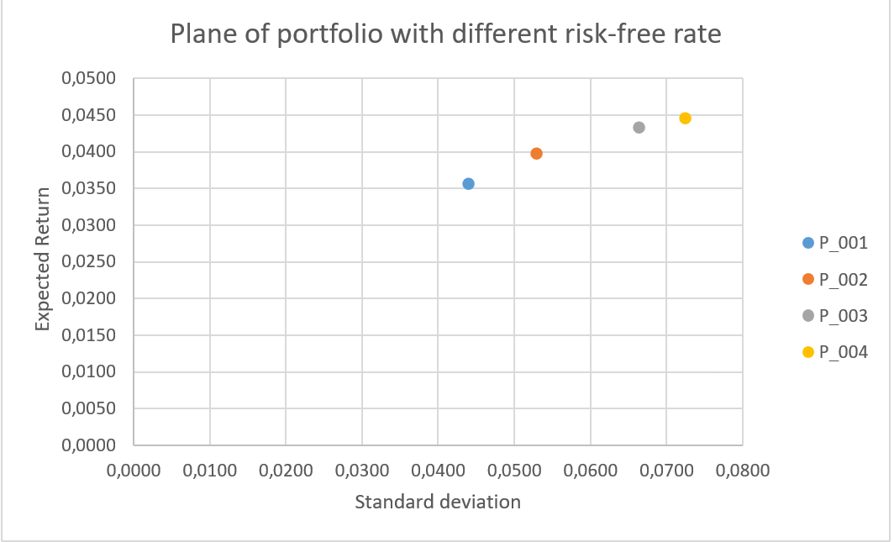
By using the information of the table, we plotted the plane where can look different portfolio position with given expected return and standard deviation.

Slide 12
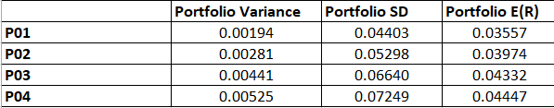
2.4 exercise
This part refers to a process of finding the optimal portfolio by using model called Markowitz Mean-Variance optimization. The model takes into account the expected returns and risk (measured by variance) of 5 different assets
to minimize the portfolio variance while ensuring that the expected return values obtained from a previous Sharpe ratio optimization.
So the result of this optimization was compared to the result of the Sharpe ratio optimization, and we found that the results were same. Meaning that the both model is able to effectively balance the portfolio's risk and return.

Slide 13
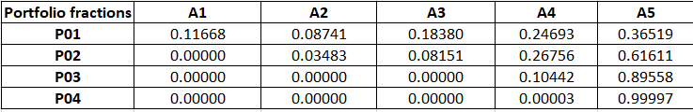
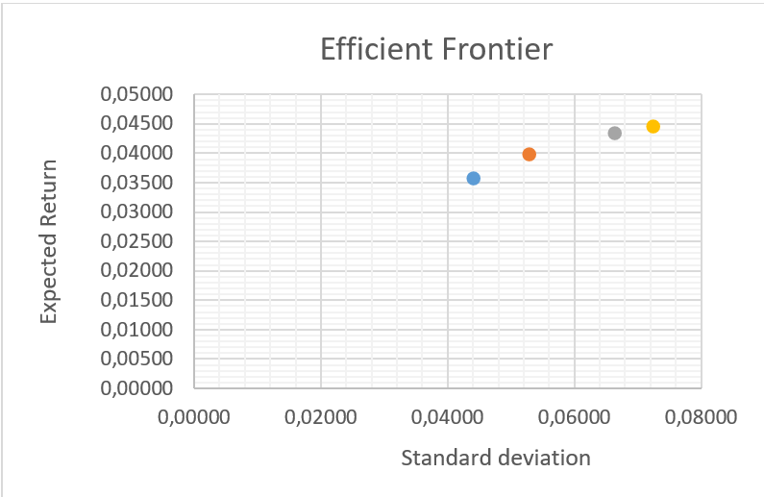
But different optimal combination of asset fractions..
Finally, the 4 points representing the solutions were plotted in the plane with standard deviation (σ) on the x-axis and expected return (µ) on the y-axis. This represents the efficient frontier in the risk-return plane.

